Slide 1

MSE 311: Thermodynamics of Materials
Lecture 7: TD relationships
2022 Fall
Weishu Liu
Department of Materials Science and Engineering
Southern University of Science and Technology (SUSTech)
Email: liuws@sustech.edu.cn
Office: North Tower 1#, Rm310

Slide 2
13. Gibbs Free Energy
Chapter 5：
Introduction to the thermodynamics of materials,
6th edition, by David R. Gaskell, Talor & Francis Press, 2018

Slide 3
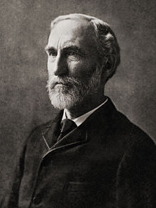
Josiah Willard Gibbs
1901年
伦琴（英国）：物理学奖，
“发现X射线获奖的德国科学家”；
范托霍夫(荷兰)：化学奖，
“化学动力学和渗透压定律获奖”
书香世家
Josiah Willard Gibbs
1839-1903
1902年
洛伦兹 (荷兰)，塞曼(荷兰)：物理学奖
“电子理论、磁光效应”
埃米尔·费雪(德国)：化学奖
“糖的结构”
1863, Yale awarded Gibbs the first American doctorate in engineering.
On his father's side, he was descended from Samuel Willard, who served as acting President of Harvard College from 1701 to 1707.
On his mother's side, one of his ancestors was the Rev. Jonathan Dickinson, the first president of the College of New Jersey (later Princeton University)
1903年
亨利(法国)，居里夫妇（法国）
“放射性”
” (荷兰)，塞曼(荷兰)：物理学奖
WWI: 1914 ~1918
WWII: 1939 ~1945

Slide 4
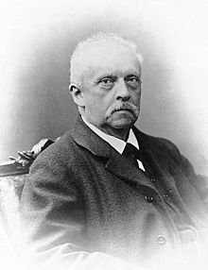
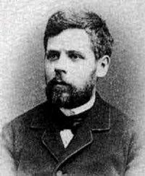
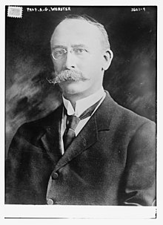
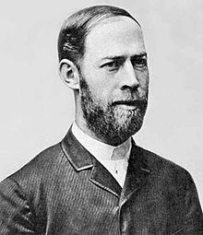
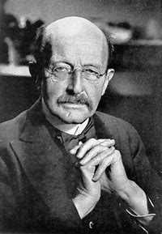
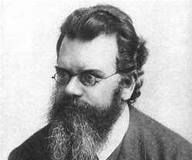
Hermann von Helmholtz
1821-1894
Ludwig Boltzmann
Friedrich Schottky
Heinrich Hertz
Max Planck
Arthur Webster
1844-1906
1851-1935
1857-1894
1858-1933
1863-1923
Age: 62
Age: 84
Age: 37
Age: 75
Age: 60
1918, Nobel prize
1899，APS founder
1903 , Nation. Aca. of Sci.
Notes:
第一届诺贝尔奖于1901年12月10日颁发

Slide 5
Thermodynamics free energy
Thermodynamic free energy,
the energy in a physical system that can be converted to do work
Gibbs Free Energy G,
----the energy that can be converted into work at a constant T and P
throughout the system
Helmholtz Free Energy A, or F
----the energy that can be converted into work at a constant T and V

Slide 6
Thermodynamics free energy
Thermodynamic free energy,
the energy in a physical system that can be converted to do work
Helmholtz Free Energy A, or F
----the energy that can be converted into work at a constant T and V
Gibbs Free Energy G,
----the energy that can be converted into work at a constant T and P
throughout the system

Slide 7
Helmholtz Free Energy A=U-TS
Why Helmholtz Free Energy provide a criterion for equilibrium
in a system at a constant T and V?
A close system undergoing
a change from state 1 to state 2
Furthermore , for a isothermal process conducted at a constant volume, which does not perform P-V work, i.e. w=0
For a isothermal process,
For a spontaneous process
dS_{irr} is always positive →A decreases during a spontaneous process
q
The criterion for equilibrium in a system at a constant T and V:

Slide 8
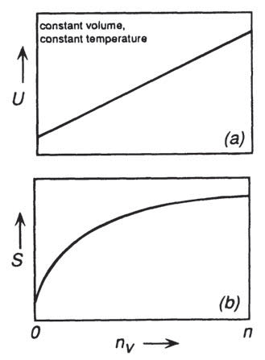
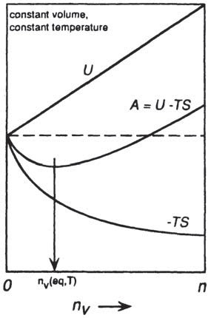
Evaporation at constant T and V
q
Evaporation at constant T and V
atoms are removed from the solid and placed in the vapor phase, heat continues to flow from the heat reservoir, and the internal energy and the entropy of the system continue to increase
In this state the solid exerts its equilibrium vapor pressure at the temperature T
V is the volume of the containing vessel
V_{s} is the volume of the solid phase present

Slide 9
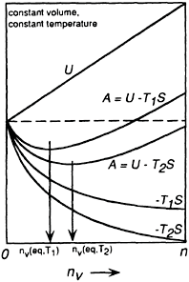

Evaporation at constant T and V
the saturated vapor pressure
For example, the saturated vapor pressure of solid CO₂, “dry ice”
The saturated vapor pressure of dry ice
increases from 0.01 atm at 151.2 K,
to 0.1 atm at 170.2 K,
to 1 atm at 194.6 K.

Slide 10
Gibbs Free Energy G=H-TS
Why Gibbs Free Energy provide a criterion for equilibrium
in a system at a constant T and P?
A close system undergoing
a change from state 1 to state 2
If only PV work consider, w’ =0
For a spontaneous process
dS_{irr} is always positive →G decreases during a spontaneous process
Consider the process under constant T and P
If system perform PV work and other form work w’
The criterion for equilibrium in a system at a constant T and P:

Slide 11
Gibbs’ Equation
1st law
2st law
Gibbs’ equation plays a fundamental role in equilibrium thermodynamics.
Gibbs’ equation is one of the pillars of the Classical Theory of Irreversible Processes.

Slide 12
Differential of the state functions
For a incremental change in the state of a closed system

Slide 13
Differential equations of the state functions
Helmholtz Free Energy
Gibbs Free Energy
Thermodynamic state variable: U, H, A, G
Thermodynamic state variable: T, P, V, S

Slide 14
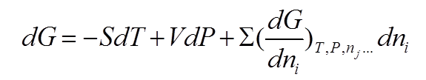
Chemical Potential
Chemical Potential
This equation can be used to describe open systems and close systems
Similarly,

Slide 15
Chemical Potential
Similarly, we can prove

Slide 16
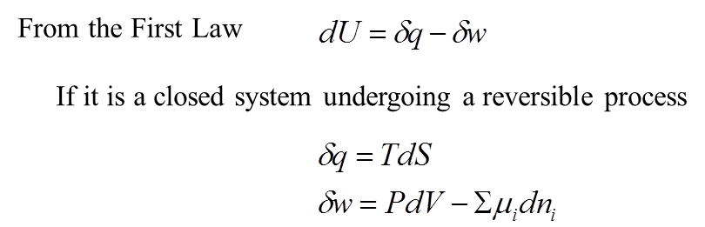
Chemical Potential
PdV : P-V work
μ_{i}dn_{i} : chemical work

Slide 17
Connections of U, H, A and G
Internal energy
Helmholtz Free Energy
dU
-d(TS)
dA
+d(PV)
+d(PV)
dH
-d(TS)
dG
Enthalpy
Gibbs Free Energy

Slide 18
14. Thermodynamic Relations
Chapter 5：
Introduction to the thermodynamics of materials,
6th edition, by David R. Gaskell, Talor & Francis Press, 2018

Slide 19
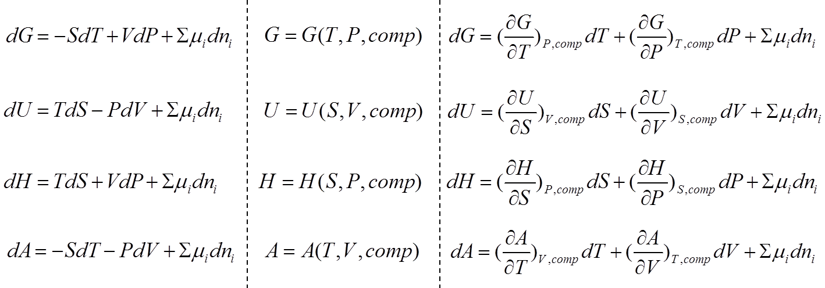
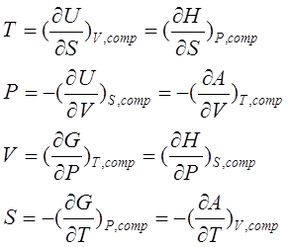
Thermodynamic Relations

Slide 20
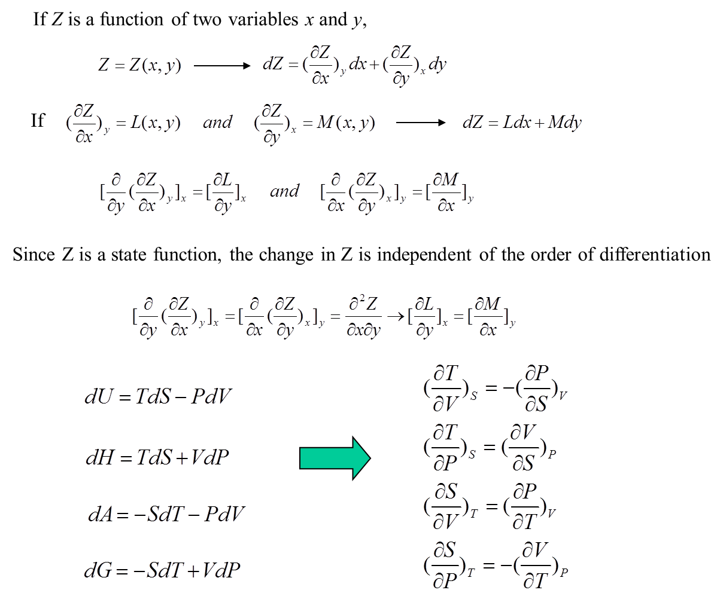
Maxwell’s Equations

Slide 21
Thermodynamics square
Extensive
parameter
Intensive
parameter
V
A
T
V
T
U
G
S
P
S
P
S
P
H
V
S
P
T
P
T

Slide 22
Reciprocal relation and ratio relation
Consider a closed system with fixed composition having three state function, X, Y, Z
Example:
Reciprocal relation
For a incremental change, i.e. dX→0
Ratio relation
Cyclical rule
Triple product rule
Euler's chain rule
Upstairs-Downstairs-Inside-Out Formula
…

Slide 23
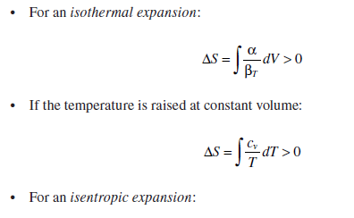
1st TdS equation
1st TdS equation

Slide 24
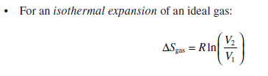
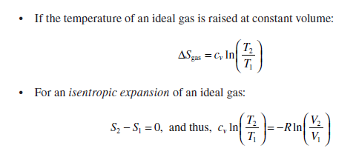

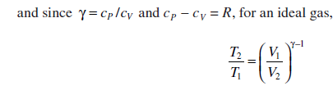
1st TdS equation
For the 1 mol idea gas
Integration with assumption of c_{v} =const.:

Slide 25
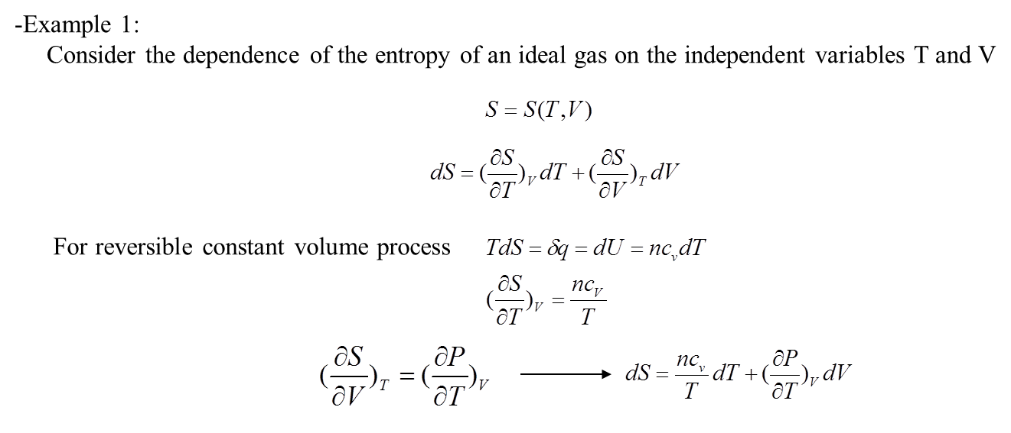
Application: 1st TdS equation
α: coefficient of thermal expansion
β_{T}: coefficient of isothermal compression
Notes:
有更正

Slide 26
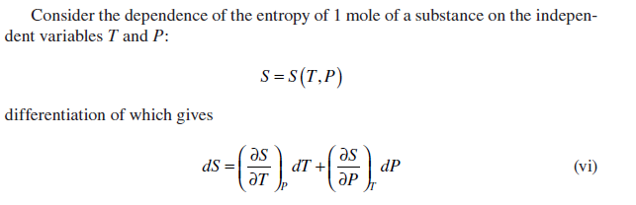

2nd TdS equation
For reversible constant pressure :
α: coefficient of thermal expansion
β_{T}: coefficient of isothermal compression

Slide 27
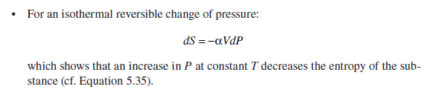
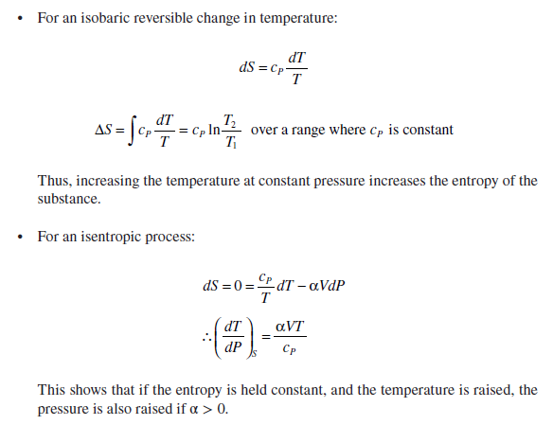
2nd TdS equation

Slide 28
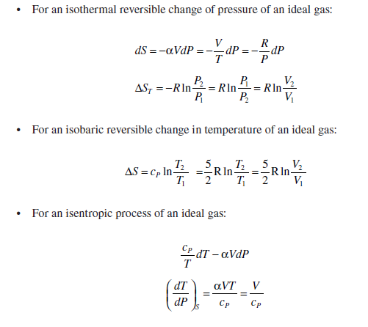

2nd TdS equation
For the 1 mol idea gas
Apply Maxwell relationship

Slide 29
3nd TdS equation

Slide 30
Adiabatic Thermoelastic Effect
The adiabatic thermoelastic effect describes the change in temperature with pressure for a brittle solid when it is loaded rapidly (i.e., the rate of loading is much more rapid than the rate of heat transfer). this effect has been use to measure the stresses that develop around defects in composite materials using cyclic loading and a high-speed thermal imaging camera.
Using Maxwell relations，derive an expression for the adiabatic thermoelastic effect. Estimate the change in temperature for one mole of alumina that is loaded to 500 MPa.
The problem requires calculation of the variation in temperature with pressure at constant entropy-that is,
.

Slide 31
the variation in temperature with pressure at constant entropy-that is
It is reasonable to assume that Al2O3 is an incompressible solid and that its heat capacity does not vary significantly over small ranges of temperature and pressure.
Thus, the variables can be separated for integration.
Thus T2=299 K and ΔT=299-298K=1.0K

Slide 32
Elastic, Magnetic, electric contribution to the free energy
From first law
P-V work
Chemical work
Elastic work
σ and ε are the strain and stress
Magnetic work
H and B are the magnetic field
strength and induction
Electric work
E and D are the electric filed
strength and displacement
Ref. ZiKui Liu and Yi Wang,
computation of thermodynamics of materials，Cambridge Press, 2016

Slide 33
The general Maxwell relations

Slide 34
15. The general strategy for the derivation
of thermodynamic relation
Ref. Robert Dehoff, CRC Press, (2006)
Thermodynamics in Materials Science： Chapter 4

Slide 35
Volume relations to the T and P
Coefficient of thermal expansion
Coefficient of compressibility

Slide 36
Entropy relations to the T and P
Apply Maxwell equation,
For a constant pressure,
Coefficient of compressibility,

Slide 37
Energy function expressed of T and P
Determinant form:

Slide 38
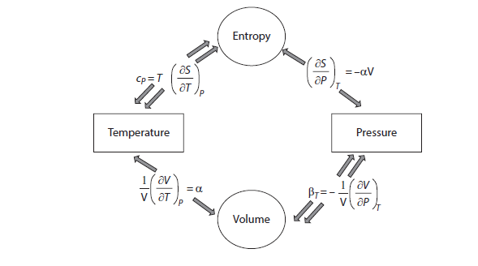
Intrinsic relationship
Determinant form:

Slide 39
Related the entropy of system to T and V
1. Identify the variable: S=S(T, V)
2. Write the differential form : dS=MdT+NdV
3. Convert dV:
4. Collect item
5. Obtain S=S(T, P) form the table
6. Compare the coefficient
S=S(T, V)
7. Solve the equation for M and N

Slide 40
Related the entropy of system to P and V
1. Identify the variable: S=S(P, V)
2. Write the differential form : dS=MdP+NdV
3. Convert dV:
4. Collect item
5. Obtain S=S(T, P) form the table
6. Compare the coefficient
7. Solve the equation for M and N
S=S(P, V)

Slide 41
Applied to idea gas
The equation of idea gas
For 1mol gas, i.e. n=1

Slide 43
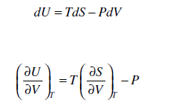
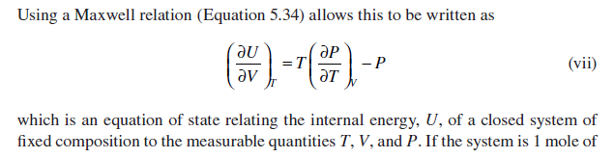
Another application of Maxwell equations
Energy relation for a close system of fixed composition:

Slide 44
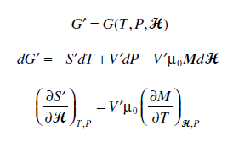
Magnetic Maxwell relationship
For a single-component material under the influence of an external magnetic field
S, V, M as a function of T,P, H

Slide 45
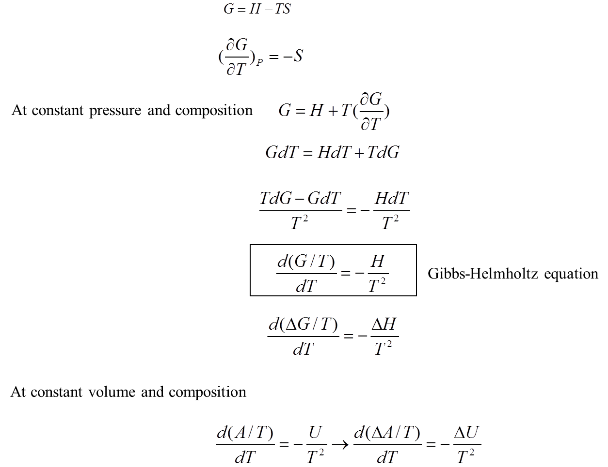
Gibbs-Helmholtz Equation

Slide 46
Gibbs-Helmholtz Equation
Gibbs free energy
Helmholtz free energy
It is applicable to a close system of fixed composition sundering process at constant pressure
Josiah Willard Gibbs
1839-1903
Hermann von Helmholtz
1821-1894
Notes:
Josiah Willard Gibbs, Yale College
On his father's side, he was descended from Samuel Willard, who served as acting President of Harvard College from 1701 to 1707. On his mother's side, one of his ancestors was the Rev. Jonathan Dickinson, the first president of the College of New Jersey (later Princeton University)
In 1863, Yale awarded Gibbs the first American doctorate in engineering.
Hermann von Helmholtz: University of Berlin;
PhD.: Max Planck; Heinrich Hertz; Friedrich Schottky; Arthur Gordon Webster; Ludwig Boltzmann
Friedrich Schottky:
He is also the father of Walter H. Schottky, the German physicist and inventor of a variety of semiconductor concepts.

